Slide 1

Computer Architecture

Slide 2
Hardware
Hardware
BIOS and CMOS
POST
Power Supplies

Slide 3
BIOS and CMOS
BIOS (Basic Input / Output System):
Next to the CPU, the BIOS (basic input/output system) chip is the most important chip found on the motherboard.
The BIOS,
  Tells the CPU what drives are connected to the computer
  Turns on and off USB ports
  Tells the CPU when memory is ready to be written to or read from
  Perform a POST test on boot up

Slide 4
BIOS and CMOS
The BIOS is firmware (“software on a chip”), and it performs a lot of different jobs during system operation.
The BIOS is a ROM chip and consequently does not require electricity to maintain its data.
On systems that use 32-bit versions of Microsoft Windows (Windows 95 or newer), the BIOS doesn’t do much after the boot (system start up) process has been completed.

Slide 5
BIOS and CMOS
The major jobs the BIOS performs
Configuration and control of devices built into the motherboard; these are sometimes referred to as standard devices
The power-on self-test (POST)
The location of an operating system, to which it turns over control of the system by using the Bootstrap loader
The BIOS doesn’t do its job alone. It works with two other important components: CMOS memory Motherboard battery (also called the CMOS battery)

Slide 6
BIOS and CMOS
What does the BIOS control?
The BIOS is a complex piece of firmware (“software on a chip”) that provides support for the following devices and features of your system:
Selection and configuration of storage devices connected to the motherboard’s host adapters, such as hard drives, and CD-ROM drives
Configuration of main and cache memory
Configuration of built-in ports.

Slide 7
BIOS and CMOS
Configuration of integrated (built into the motherboard chipset) audio, network, and graphics features when present
Selection and configuration of special motherboard features, such as memory error correction, antivirus protection, and fast memory access
Support for different CPU types, speeds, and special features
Support for advanced operating systems, including networks and plug-and play versions of Windows
Power management
Hardware monitoring (processor temperature, voltage levels, and fan performance)

Slide 8
BIOS and CMOS
Storing System Settings
To enable the BIOS to perform these tasks, two other components on the motherboard work with the BIOS: the CMOS chip, also known as the NVRAM/RTC (non-volatile RAM/real-time clock), and the battery.
The CMOS stores the settings that you make with the BIOS configuration program and contains the system’s real-time-clock circuit.
Power from a battery attached to the motherboard is used by the CMOS to keep its settings; thus, the CMOS RAM is “non-volatile” as long as the battery is working.

Slide 9
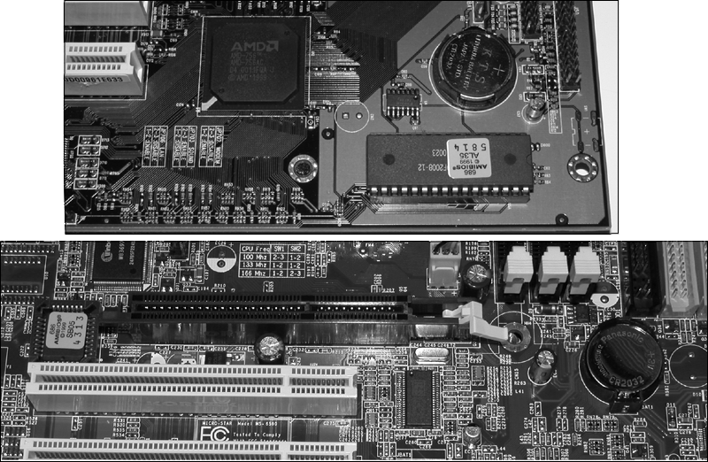
BIOS and CMOS
BIOS
CMOS
Battery

Slide 10
BIOS and CMOS
POST (power-on self-test):
Every time you turn on your PC, the BIOS performs one of its most important jobs: the POST (power-on self-test).
The POST portion of the BIOS enables the BIOS to find and report errors in the computer’s hardware.

Slide 11
BIOS and CMOS
The POST checks the following parts of the computer:
The CPU and the POST ROM portion of the BIOS
The system timer
Video display (graphics) card
Memory
The keyboard
The disk drives

Slide 12
BIOS and CMOS
During the POST process, the BIOS uses any one of several methods to report problems:
Beep codes
POST error messages (displayed on the monitor)
POST (hex) error codes

Slide 13
BIOS and CMOS
Beep Codes
Beep codes are used by most BIOS versions to indicate either a fatal error or a very serious error.
A fatal error is an error that is so serious that the computer cannot continue the boot process.
A fatal error would include a problem with the CPU, the POST ROM, the system timer, or memory.
The serious error that beep codes report is a problem with your video display card or circuit.

Slide 14
BIOS and CMOS
Beep codes vary by the BIOS maker. Some companies, such as IBM, Acer, and Compaq, create their own BIOS chips and firmware.
However, most other major brands of computers and virtually all “clones” use a BIOS made by one of the “Big Three” BIOS vendors: American Megatrends (AMI), Phoenix Technologies, and Award Software (now owned by Phoenix Technologies).
All beep codes vary greatly depending on vender.

Slide 15
BIOS and CMOS
Post Error Messages
Most BIOS versions do an excellent job of displaying POST error messages indicating what the problem is with the system.
These messages can indicate problems with memory, keyboards, hard disk drives, and other components.
Some Systems document these messages in their manuals, or you can go to the BIOS vendors’ Web site for more information.

Slide 16
BIOS and CMOS
POST (Hex) Codes and POST Cards
The POST uses an I/O port address, sending a series of codes indicating the progress of testing and booting.
The hexadecimal codes output by the BIOS change rapidly during a normal start-up process as different milestones in the boot process are reached.
These codes provide vital clues about what has gone wrong when your system won’t boot and you don’t have a beep code or onscreen messages to help you.

Slide 17
BIOS and CMOS
To monitor these codes, you need a POST card such as the one shown on next slide.
These cards are available in versions that plug into either ISA or PCI expansion slots.
The simplest ones have a two digit LED area that displays the hex codes, whereas more complicated (and expensive) models also have additional built-in tests.
The same hex code has different meanings to different BIOSs. For example, POST code 31h means “display (video) memory read/write test” on an AMI BIOS, but it means “test base and extended memory” on the Award BIOS, and it is not used on the Phoenix BIOS.

Slide 18
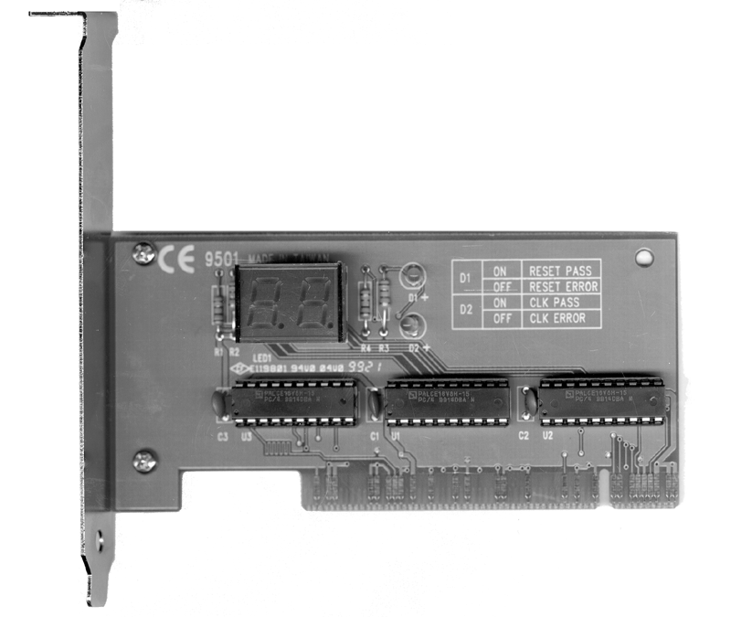
BIOS and CMOS
Signal lights
POST code readout
Legend for signal lights

Slide 19
BIOS and CMOS
Transferring control to the OS with the Bootstrap loader:
When the POST has done its job, if it finds no errors, it’s time for the BIOS to do the next job on its to-do list.
Next, the BIOS searches for an operating system on the drives listed in the BIOS configuration as bootable drives. On most systems, bootable drives can be hard disks, floppy disks (stone age), or optical disks. A few recent systems can also boot from drives connected to the USB port.
The first drive containing an operating system will be used to start the computer, and at that point the BIOS says to the operating system, “Here, you take over,” and transfers control of most of the computer to the operating system. The portion of the BIOS responsible for starting the system is called the bootstrap loader.

Slide 20
BIOS and CMOS
If a drive is listed as a bootable drive but has no media in it, the BIOS skips it and moves to the next drive in the list of bootable drives. If a bootable floppy drive has a non-bootable disk inserted and the system attempts to boot from that drive, the system displays a “non-system disk” error and the boot process stops until you remove the disk from the drive.

Slide 21
BIOS and CMOS
Warm and Cold Booting
There are two ways to boot (start) your computer:
A cold boot (or hard boot) refers to starting the computer with the power or reset switch, which runs the entire POST and bootstrap process.
A warm boot (or soft boot) skips the POST and refers to restarting the computer with the MS-DOS Ctrl+Alt+Del key sequence or the Windows Start, Shutdown, Restart menu.

Slide 22
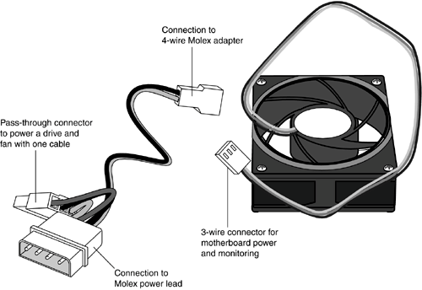
Power Supplies and Circuit Testing
Causes and cures of Power Supply Overheating:
Overloading
Fan Failure
Inadequate air flow outside the system
Inadequate air flow inside the system
Dirt and dust
Auxiliary Fans

Slide 23
Power Supplies and Circuit Testing
Avoiding Power Supply Hazards:
Never disassemble a power supply or push metal tools through the openings in the case
If you are replacing the power supply in a Dell desktop, determine whether the computer uses a standard ATX or Dell proprietary ATX power supply
Always used a properly wired and grounded outlet for your computer and its peripherals

Slide 24
Power Supplies and Circuit Testing
Problems with AC Power:
Problems with AC power
  Overvoltages (Spikes and surges)
  Undervoltages (brownouts)
  Power Failure (blackouts)
  Noisy Power (interference)

Slide 25
Power Supplies and Circuit Testing
Power Protection Types:
Surge Suppressors
Battery Backup systems
  UPS (uninterruptible power supply)
  SPS (standby power supply)
Power conditioning devices

Slide 26
Power Supplies and Circuit Testing
Surge Suppressors:
While properly designed surge suppressors can prevent power surges (chronic over-voltage) and spikes (brief extremely high voltage) from damaging your computer, low-cost ones are often useless because they lack sufficient components to absorb dangerous surges.

Slide 27
Power Supplies and Circuit Testing
UPS:
A UPS (uninterruptible power supply) is another name for a battery backup unit. A UPS provides emergency power when a power failure strikes (a blackout) or when power falls below minimum levels (a brownout).
There are two different types of UPS systems: true UPS and SPS systems. A true UPS runs your computer from its battery at all times, isolating the computer and monitor from AC power.

Slide 28
Power Supplies and Circuit Testing
There is no switchover time with a true UPS when AC power fails because the battery is already running the computer. A true UPS inherently provides power conditioning (preventing spikes, surges, and brownouts from reaching the computer) because the computer receives only battery power, not the AC power coming from the wall outlet.
True UPS units are sometimes referred to as line-interactive battery backup units because the battery backup unit interacts with the AC line, rather than the AC line going directly to the computer and other components.

Slide 29
Power Supplies and Circuit Testing
SPS:
An SPS (standby power supply) is also referred to as a UPS, but its design is quite different. Its battery is used only when AC power fails.
A momentary gap in power (about 1ms or less) occurs between the loss of AC power and the start of standby battery power; however, this switchover time is far faster than is required to avoid system shutdown because computers can coast for several milliseconds before shutting down.
SPS-type battery backup units are far less expensive than true UPSs, but work just as well as true UPSs when properly equipped with power-conditioning features.

Slide 30
The end
That’s all

